Slide 1
Spy ToolKit
By Group 9F

Slide 2

Introduction – Abdulkadir
What we have done so far:
Distributed workload to team members and established a hierarchy
Have set up our main plan and objectives required for our project to work properly
Split the team into groups to work on different sections of the project
Weekly consolidation and collaboration
Notes:
By established hierarchy, refer to how we have set up members to report to i.e scrum master and the team leader

Slide 3
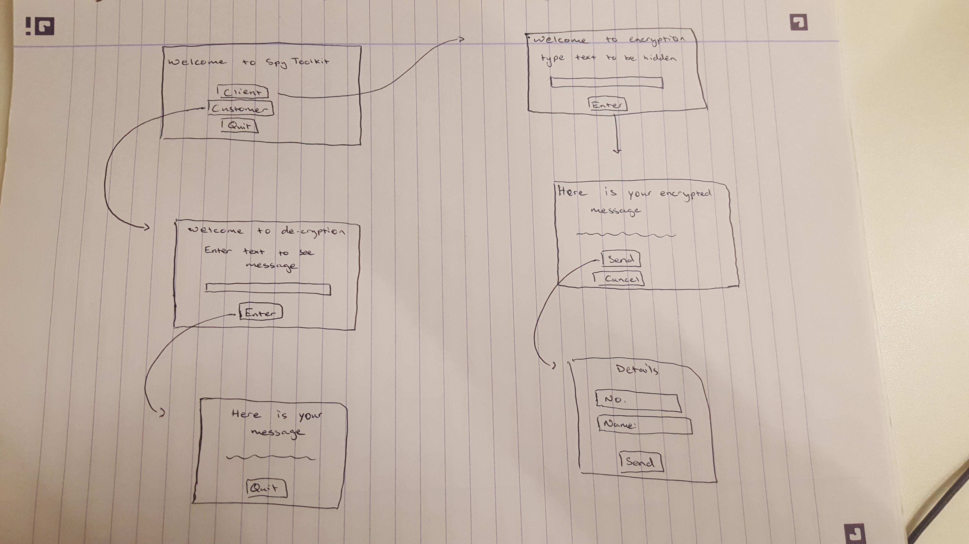
Coding Stage - Abdulkadir
Took lead on the coding stage for our sub-group
Working on making the graphical user interface for the hacking toolkit
Basic sketch-up plan for the GUI
Coding is currently being developed for the GUI.

Slide 4
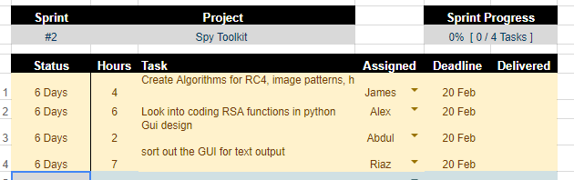
Splitting the workload - Alex
Plan of tasks to be completed
Use of the sprint tracker
Group member skills
Different tasks distributed
Communication through lab sessions and WhatsApp
Keeping track of progress
Sprint Tracker

Slide 5
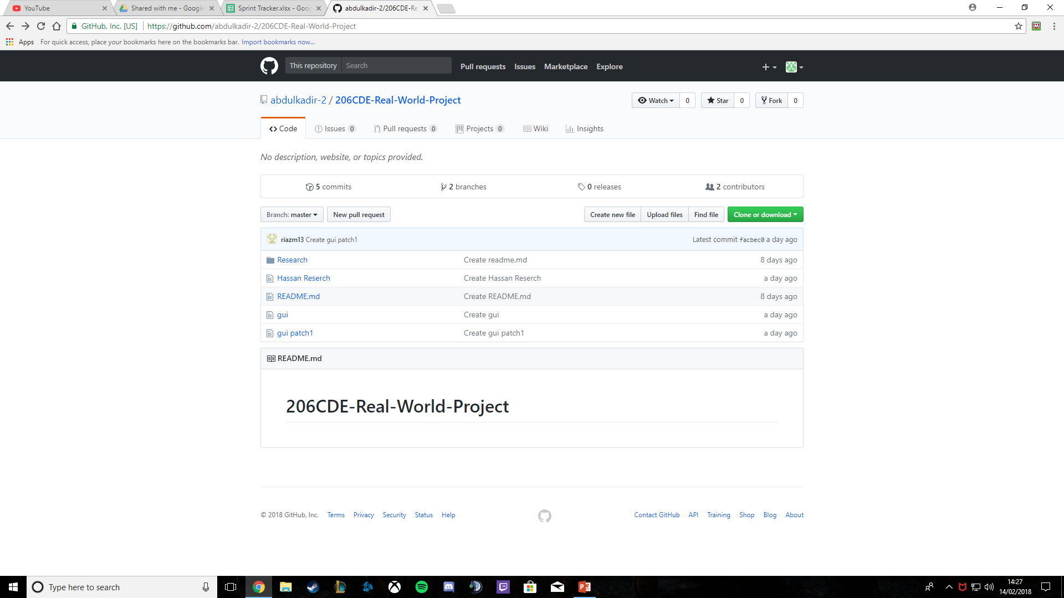
Use of GitHub - Alex
Version control – Updating work
Research material
Code material
Designs
Easy to access
See the stages of progress
See all the work in one place
GitHub Repository

Slide 6
Details (Ins and Outs) - James
The Application is a client which encrypts and decrypts text entered into it
Multiple ways of encryption
Primarily we’re using RSA public key encryption to test and measure that the system works
Secondarily we will incorporating other commonly used forms of encryption and we also will be making and implementing encryption algorithms of our own design
Stenography
Hiding text in images

Slide 7
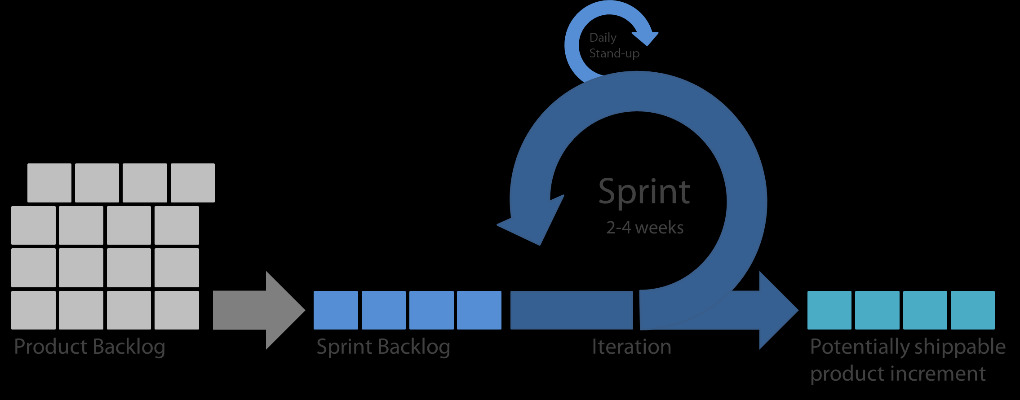
Plan - James
General outline:
Research encryption
Design GUI and algorithms
Implement Design
Build a prototype
Test and Improve
Final Testing and Maintenance

Slide 8
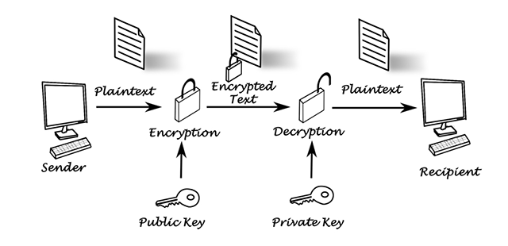
Who will it be useful for? - Riaz
Governments
Spies
Organisations
The kinds of people that will use the encryption service will be people that have something that they want to hide from other people, E.g. encrypting files on servers to make sure that people aren't able to read new research that a company is doing.

Slide 9
We will include:
If we have time:
We would like:
An encrypted text chat so that the different parties are able to talk to each other without third parties being able to read the chats.
Have the software able to send other file types like .pdf and .jpg.
Add a feature that allows users to predetermine a message that they are going to send, E.G. assign a message to send at 10pm and the message will automatically be sent at that time.

Slide 10
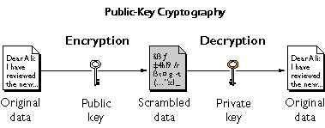
Types of Encryption – Hassan
Triple DES
Triple DES is an encryption method which replaced the original Data encryption as hankers managed to solve the older encryption method with ease. Triple DES was recommended for the best encryption and was widely used around the world as it was safe.
Triple DES makes a use of 3 individual keys which are each 56 bits which means that this total key length is 168 bits. Even though, Triple Des is slowly being phased out Triple DES is still a suitable able and trustable encryption solution which is still used within industries.
RSA
RSA is a public-key encryption algorithm and the standard for encrypting data sent over the internet.
Unlike Triple DES, RSA is considered an asymmetric algorithm due to its use of a pair of keys. You’ve got your public key, which is what we use to encrypt our message, and a private key to decrypt it. The result of RSA encryption is a huge batch of mumbo jumbo that takes attackers quite a bit of time and processing power to break.
Blowfish
Blowfish is yet another algorithm designed to replace DES. This splits messages into 64 bits and encrypts them individually.
Blowfish is known for both its speed and effectiveness as people claim that it has never been defeated. Meanwhile, users have taken full advantage of its free availability in the public domain.
Blowfish can be found in e-commerce platforms for securing payments to password management tools, where it used to protect passwords. It’s definitely one of the more flexible encryption methods available.
Twofish
Twofish is owned by the same produces as blowfish where Keys used in this algorithm may be up to 256 bits in length and as a symmetric technique, only one key is needed.
Twofish is regarded as one of the fastest of its kind, and ideal for use in both hardware and software environments.
Like Blowfish, Twofish is freely available to anyone who wants to use it. As a result, you’ll find it bundled in encryption programs such as Photo Encrypt, GPG, and the popular open source software TrueCr ypt.
AES
The Advanced Encryption Standard (AES) is very trusted and used by the U.S. Government.
This encryption is used for heavy duty encryption purposes and it is extremely efficient as it is in form of 128 bits. This also uses keys of 192 and 256 bit.
AES is considered to be attack proof and it uses a combination of all 128, 192 and/or 256 bit. However, the security experts still believe that it will be hailed eventually by the hackers and it might get attacked so they are trying to make something even better.

Slide 11

Future of Encryption - Hassan
Cyber attacks are evolving which means that the security specialists are still working on improving Encryption, they are hopeful that the new method which is known as Honey encryption will prevent the hackers by giving them false data when they try to hack the company and the fake data will be given for each incorrect code that they add.
This will make the hackers think that they have the real data when they will be having fake data and they will eventually stop hacking thinking that they have the right data.
Whether it is emails or stored data, encryption should always be used as it is an important security tool. It is not 100% safe but it is always better to have protection than not using any protection.

Slide 12
Any Questions?

